Slide 1
Unit 4
By: Amanpal Singh

Slide 2
Content
Working with Tables : Colspan and Rowspan, applying css on tables, creating hoverable tables
Working with Forms : action attribute, get and post methods, Form Elements and Controls Like Text Inputs, TextArea, Buttons, CheckBoxes, Dropdown Boxes, Radio Buttons, Select and File Select, applying css on all controls of forms
CSS Grids and Webpage Layouts : Grid introduction, Grid container, Grid Item, Creating different layouts for webpage.

Slide 3
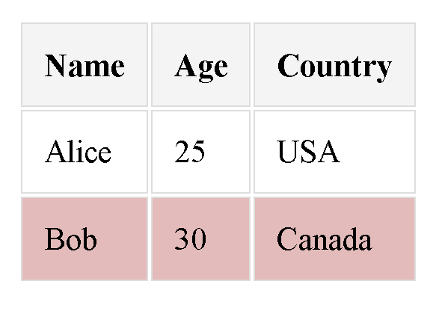
Hover effect [table]
<html><head></head><body>
<head><style>
table {border-collapse: separate;margin: 20px;font-size: 18px;
}
th, td {padding: 12px;border: 1px solid #ddd;}
th { background-color: #f4f4f4;}
/* Hover effect */
tr:hover {background-color: #ebb9b9;cursor: pointer;}
</style></head><body>
<table><thead> <tr><th>Name</th><th>Age</th><th>Country</th></tr>
</thead><tbody> <tr><td>Alice</td><td>25</td><td>USA</td> </tr>
<tr><td>Bob</td><td>30</td><td>Canada</td>
</tr> </tbody> </table>
</body> </html>

Slide 4
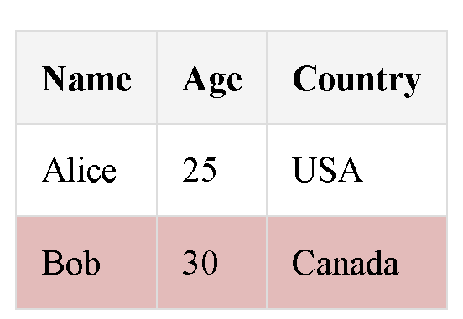
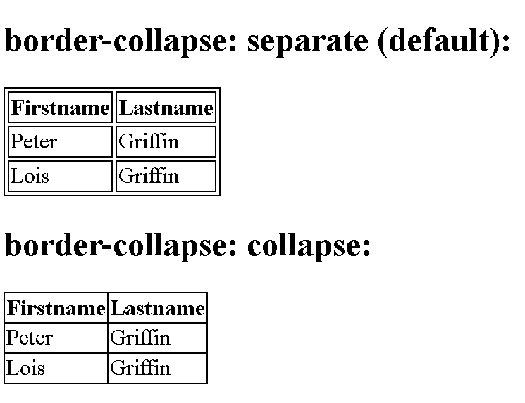
border-collapse [table]
<html><head></head><body>
<head><style>
table {border-collapse: collapse; margin: 20px;font-size: 18px;
}
th, td {padding: 12px;border: 1px solid #ddd;}
th { background-color: #f4f4f4;}
/* Hover effect */
tr:hover {background-color: #ebb9b9;cursor: pointer;}
</style></head><body>
<table><thead> <tr><th>Name</th><th>Age</th><th>Country</th></tr>
</thead><tbody> <tr><td>Alice</td><td>25</td><td>USA</td> </tr>
<tr><td>Bob</td><td>30</td><td>Canada</td>
</tr> </tbody> </table>
</body> </html>

Slide 5
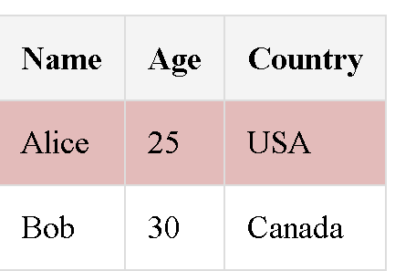
creating hover [tables]
<head><style>
table {border-collapse: collapse;margin: 20px;font-size: 18px;
}
th, td {padding: 12px;border: 1px solid #ddd;}
th { background-color: #f4f4f4;}
/* Hover effect */
tr:hover {background-color: #ebb9b9;cursor: pointer;}
</style></head><body>
<table><thead> <tr><th>Name</th><th>Age</th><th>Country</th></tr>
</thead><tbody> <tr><td>Alice</td><td>25</td><td>USA</td> </tr>
<tr><td>Bob</td><td>30</td><td>Canada</td>
</tr> </tbody> </table>

Slide 6
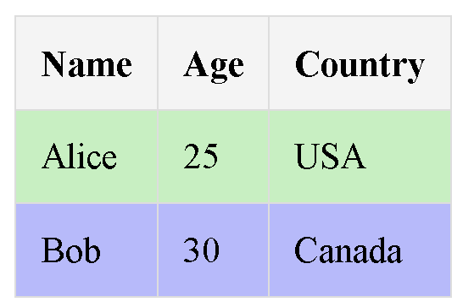
<html><head></head><body> <head><style>
table {border-collapse: collapse;margin: 20px;font-size: 18px;
}
th, td {padding: 12px;border: 1px solid #ddd;}
th { background-color: #f4f4f4;}
/* Alternate Effect */
tr:nth-child(odd) {background-color: rgb(190, 240, 190);}
tr:nth-child(even) {background-color: rgb(182, 186, 255);}
/* Hover effect */
tr:hover {background-color: #ebb9b9;cursor: pointer;}
</style></head><body>
<table><thead> <tr><th>Name</th><th>Age</th><th>Country</th></tr>
</thead><tbody> <tr><td>Alice</td><td>25</td><td>USA</td> </tr>
<tr><td>Bob</td><td>30</td><td>Canada</td>
</tr> </tbody> </table> </body> </html>

Slide 7
form
<form method="GET" action="" >
<label>Label</label><br><br>
<input type="text" name="username" id="username"><br><br>
<input type="password" name="password" id="password"><br><br>
<input type="Radio" name="OptionA" id="OptionA">Option 1<br>
<input type="Radio" name="OptionB" id="OptionB">Option 2<br><br>
<input type="Checkbox" name="Check1" id="Check1">Check 1<br>
<input type="Checkbox" name="Check1" id="Check1">Check 2<br><br>
<input type="button" value="OK" id="btnOK"><br><br>
<input type="submit" value="submit" id="fname"><br><br>
<input type="reset"><br><br>
<input type="file"><br><br>
<input type="hidden"><br><br>
<input type="image" value="OK" width=50 src="1.jpg"><br><br>

Slide 8
<input type="color"><br><br>
<input type="date"><br><br>
<input type="datetime-local"><br><br>
<input type="email"><br><br>
Email : <input type="email" name="email" size="30" maxLength="30"
placeholder="username@pst.com" pattern=".+@pst.com">
Month : <input type="month"><br><br>
Number: <input type="number"><br><br>
range : <input type="range"><br><br>

Slide 9
search :
<input type="search" id="gsearch" name="gsearch" results=2 ><br><br>
<input type="submit"><br><br>
Tel:
<input type="tel" id="phone" name="phone" pattern="[+][0-9]{2}-[0-9]{3}"
required><br><br>
<input type="text"><br><br>
time &nbsp;<input type="time"><br><br>
url<input type="url"><br><br>
week<input type="week"><br><br>
</form>

Slide 10
Notes on GET:
Appends the form data to the URL, in name/value pairs
NEVER use GET to send sensitive data! (the submitted form data is visible in the URL!)
The length of a URL is limited (2048 characters)
Useful for form submissions where a user wants to bookmark the result
GET is good for non-secure data, like query strings in Google

Slide 11
Notes on POST:
Appends the form data inside the body of the HTTP request (the submitted form data is not shown in the URL)
POST has no size limitations, and can be used to send large amounts of data.
Form submissions with POST cannot be bookmarked

Slide 12
applying css on all controls of forms
<style>
input{
width:15%;
padding: 12px;
margin: 8px;
border: 2px solid red;
border-radius: 4px;
border-top: 3px solid blue;
border-bottom: 3px solid red;
color: rgb(217, 104, 104);
background-image: url('');
background-position: 10px 10px;
background-repeat: no-repeat;
-webkit-transition: width 1s ease-in-out;
transition: width 1s ease-in-out;
}
/*change this behaviour by using :focus selector*/
input[type=text]:focus {
width:30%;
border: 3px solid red;
background-color: green;
}
</style>

Slide 13
CSS Layout
CSS Flexible Box Layout
CSS Grid Layout

Slide 14
Before the Flexible Box Layout module, there were four layout modes:
Block, for sections in a webpage
Inline, for text
Table, for two-dimensional table data
Positioned, for explicit position of an element

Slide 15
CSS Flexbox Components
A Flex Container - the parent (container) <div> element
Flex Items - the items inside the container <div>
A Flexible Layout must have a parent element with the display property set to flex.
Direct child elements(s) of the flexible container automatically becomes flexible items.

Slide 16
CSS Flexible Box Layout
Flexible Box Layout module.
Arranging items in rows or columns.
Easier to design a flexible responsive layout structure
Consists of:
A Flex Container - the parent (container) <div> element
Flex Items - the items inside the container <div>
<div class="flex-container">
<div>1</div> <div>2</div> <div>3</div>
</div>

Slide 17
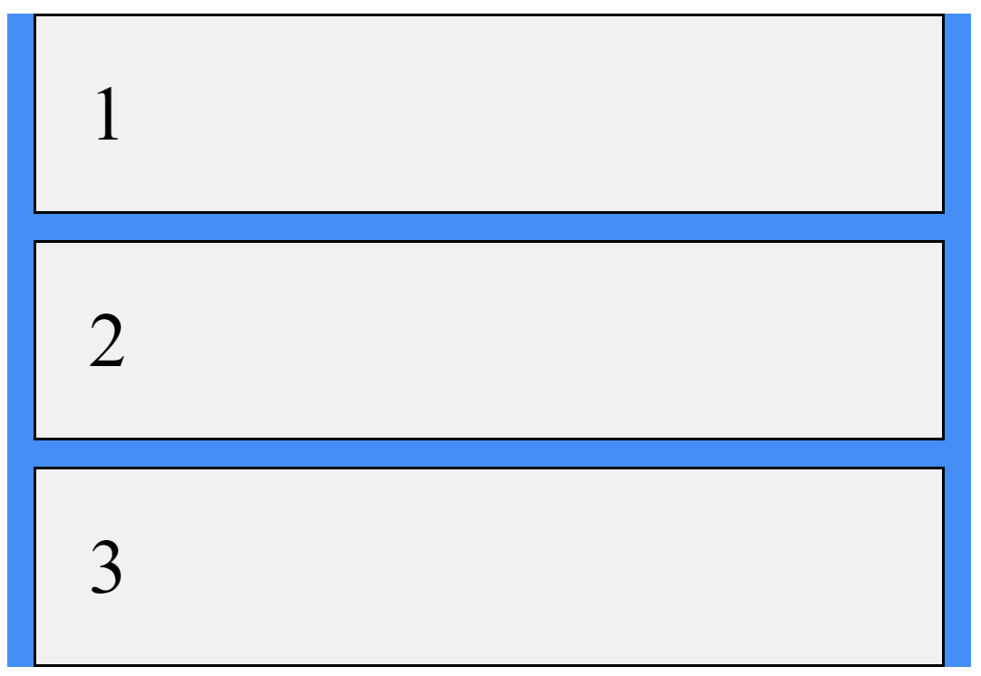
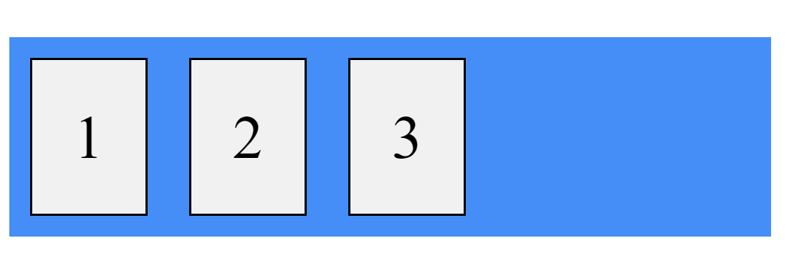
Example of display: flex
<html> <head>
<style>
.flex-container { display: flex; background-color: DodgerBlue;
margin-right: 10px;} .flex-container > div { background-color: #f1f1f1; border: solid;
margin: 10px; padding: 20px; font-size: 30px;}
</style> </head> <body> <div class="flex-container">
<div>1</div> <div>2</div> <div>3</div>
</div> </body></html>

Slide 18
flex: margin property: CSS
If the margin property has four values:
margin: 10px 5px 15px 20px;
top margin is 10px
right margin is 5px
bottom margin is 15px
left margin is 20px
.flex-container > div {
background-color: #f1f1f1;
border: solid;
margin: 10px 25px 20px 33px;
padding: 20px; font-size: 30px;
}

Slide 19
flex-grow Property:
specifies how much a flex item will grow relative to the rest of the flex items.
flex-shrink Property:
specifies how much a flex item will shrink relative to the rest of the flex items
flex-basis:
The length of the item.
Legal values: "auto", "inherit", or a number followed by "%", "px", "em" or any other length unit.

Slide 20
The CSS Flex Container
The CSS properties we use for the flex container are:
flex-direction: specifies the display-direction of flex items in the flex container.
[row, column, row-reverse, column-reverse]
flex-wrap: specifies whether the flex items should wrap or not.
[nowrap, wrap, wrap-reverse]
justify-content: used to align the flex items.
[center, flex-start, flex-end, space-around, space-between, space-evenly]
align-items: align the flex items (vertically).
[center, flex-start, flex-end, stretch, baseline, normal]

Slide 21
The CSS Flex Items
Properties we use for flex items are:
order: specifies the order of the flex items.
flex-grow: specifies how much a flex item will grow relative to the rest of the flex items.
flex-shrink: specifies how much a flex item will shrink relative to the rest of the flex items.
flex-basis: specifies the initial length of a flex item.
align-self: specifies the alignment for the selected item

Slide 22
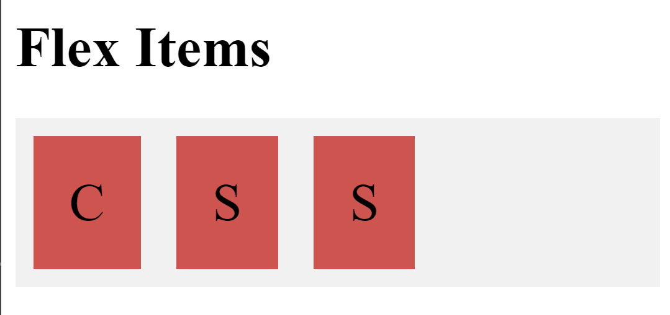
Flex example
<html> <head> <style>
.flex-container { display: flex; background-color: #f1f1f1; }
.flex-container div {
background-color: #df4a4a; margin: 10px; padding: 20px; font-size: 30px;
}
</style> </head><body>
<h1>Flex Items</h1> <div class="flex-container">
<div>C</div><div>S</div><div>S</div>
</div></body></html>

Slide 23
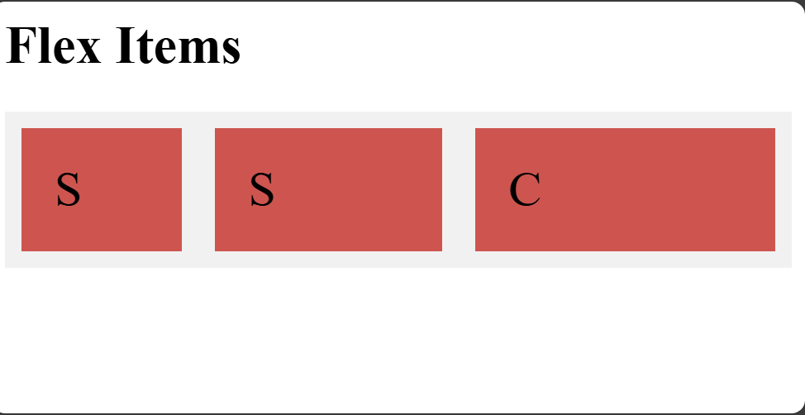
flex with attributes
<html> <head> <style>
.flex-container {display: flex; background-color: #f1f1f1; flex-direction: row-reverse; }
.flex-container div {background-color: #df4a4a; margin: 10px; padding: 20px; font-size: 30px; }
</style> </head><body>
<h1>Flex Items</h1>
<div class="flex-container">
<div style="flex-grow: 3">C</div>
<div style="flex-grow: 2">S</div>
<div style="flex-grow: 1">S</div>
</div></body></html>

Slide 24
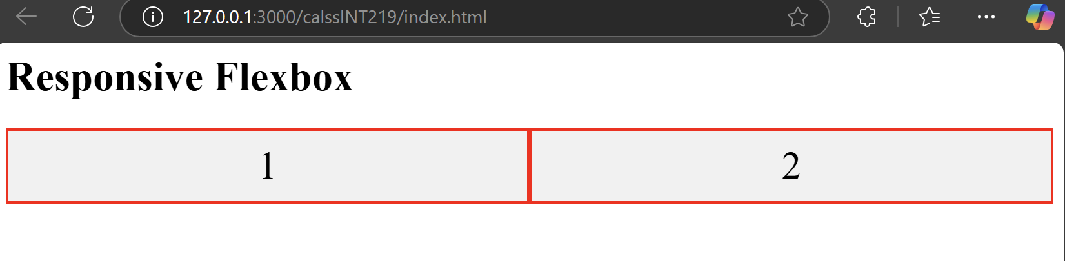
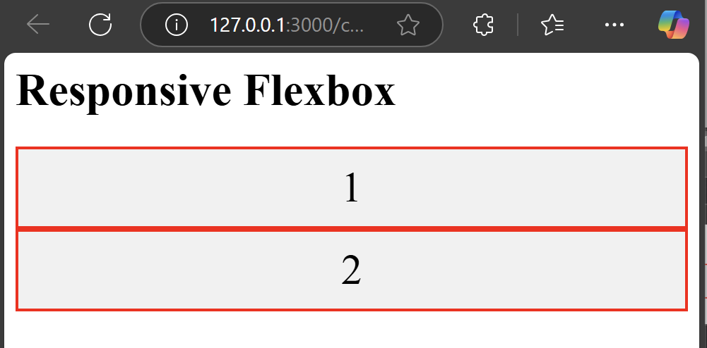
Responsive Flexbox
<html> <head> <style>
.flex-container {display: flex;flex-direction: row; font-size: 30px; text-align: center; } .flex-container > * { background-color: #f1f1f1; padding: 10px;
flex: 50%; border: 2px solid red;}
/* Responsive layout - makes a one column-layout */
@media (max-width: 800px) { .flex-container { flex-direction: column; } }
</style> </head> <body>
<h1>Responsive Flexbox</h1>
<div class="flex-container"> <div >1</div> <div>2</div>
</div> </body> </html>
@media: media query and it's essential for responsive web design.

Slide 25
flex container
A flex container is a layout component that groups and aligns elements on a web page.
It's a part of CSS Flexbox, which is a flexible box layout system.
Creating a flex container
Set the display property of the area to flex
The children of the container will become flex items

Slide 26
body { display: flex; justify-content: center; align-items: center; }
display: flex turns the body into a flex container.
justify-content: center horizontally centers the content.
align-items: center vertically centers the content.
This makes the section appear perfectly centered both vertically and horizontally.
With flex → The browser treats the body like a box where you control alignment.
Without flex → The browser treats the page like a document,
flowing from top-left like a Word document.

Slide 27
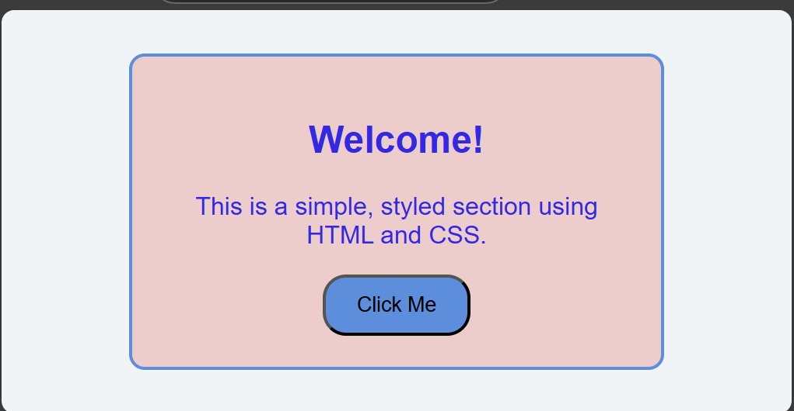
Problem 1: Build a Simple Webpage Section
Objective: Create a structured webpage section using HTML and CSS.
Instructions:
Write HTML to create a section with a heading, a paragraph, and a button.
Style the section using CSS to:
Center-align the content.
Add padding, a border, and a background color.
Use the browser’s developer tools to preview and refine the section in real-time.

Slide 28
Solution
<div> is generic and non-semantic, while <section> is semantic and defines a section of a document.
<html> <head> <style>
body {
display: flex;justify-content: center; align-items: center;
height: 100vh;
margin: 0; background-color: #f0f4f8; font-family: Arial, sans-serif; }
.content-section {
text-align: center; background-color: #f3cbcb; padding:20px;
color: rgb(54, 41, 236); border: 2px solid #4a90e2;
border-radius: 10px; width: 300px; }
.content-section button {
background-color: #4a90e2; padding: 10px 20px;
border-radius: 15px; cursor: pointer; }
.content-section button:hover {background-color: #35b869; }
</style> </head>
<body>
<section class="content-section">
<h1>Welcome!</h1>
<p>This is a simple, styled section using HTML and CSS.</p>
<button>Click Me</button>
</section> </body> </html>

Slide 29
CSS Grid Layout
Offers a grid-based layout system, with rows and columns.
Easier to design a responsive layout structure
Grid vs. Flexbox
The CSS Grid Layout should be used for two-dimensional layout, with rows AND columns.
The CSS Flexbox Layout should be used for one-dimensional layout, with rows OR columns.

Slide 30
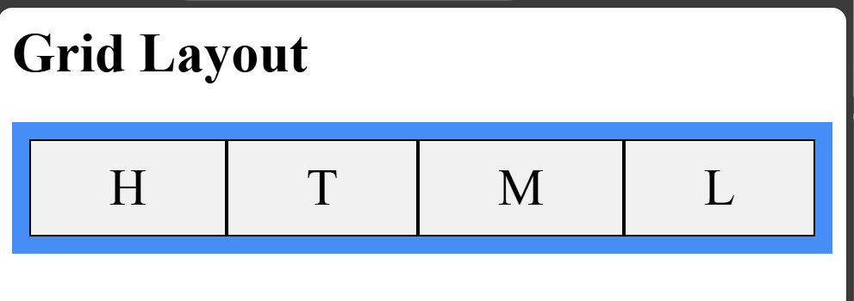
CSS Grid layout example
<html><head><style>
.container {
display: grid; grid-template-columns: auto auto auto auto;
background-color: dodgerblue; padding: 10px; }
.container > div { background-color: #f1f1f1; border: 1px solid black;
padding: 10px; font-size: 30px; text-align: center; }
</style></head><body><h1>Grid Layout</h1> <div class="container">
<div>H</div> <div>T</div> <div>M</div> <div>L</div>
</div> </body> </html>

Slide 31
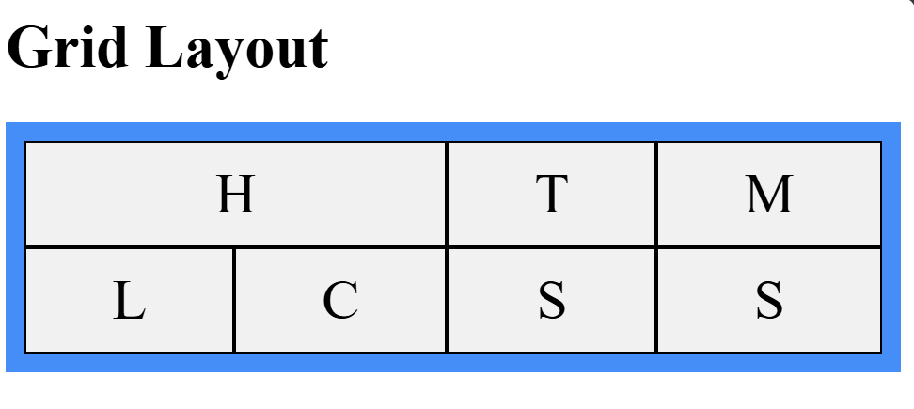
CSS Grid layout example 2
<html><head><style>
.container {
display: grid; grid-template-columns: auto auto auto auto;
background-color: dodgerblue; padding: 10px; }
.container > div { background-color: #f1f1f1; border: 1px solid black;
padding: 10px; font-size: 30px; text-align: center; }
.xx {grid-column-start: 1; grid-column-end: 3;}
</style></head><body><h1>Grid Layout</h1> <div class="container"> <div class="xx">H</div><div>T</div><div>M</div> <div>L</div><div>C</div><div>S</div><div>S</div>
</div> </body> </html>

Slide 32
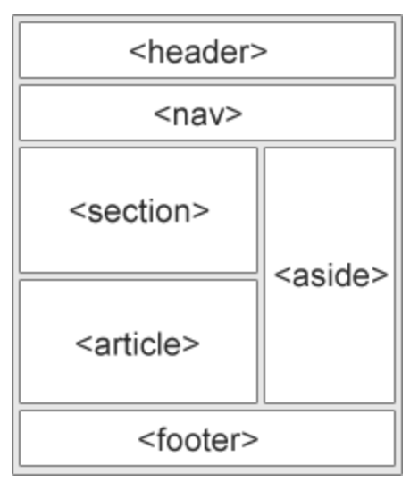
HTML Layout Elements
HTML Layout Techniques
HTML tables (Try not to use)
CSS float property
CSS framework
CSS flexbox
Layout using div

Slide 33
HTML Layout Elements: example
<body> <style>
body { display: flex; background-color: rgb(224, 136, 22); flex-direction: column; margin: 0%; height: 100vh; font-size: large; }
header, footer{background-color: brown; text-align: center; padding: 1em;}
nav{ background-color: aqua; text-align: center; padding: 1em;}
nav a{ background-color: rgb(217, 226, 43);}
main{ background-color: azure; display: flex; height: 100vh; }
section{ background-color: burlywood; width: 80%; }
aside{ background-color: darkgoldenrod; width: 20%;}
</style>
height: 100vh => 100% of the viewport height.

Slide 34
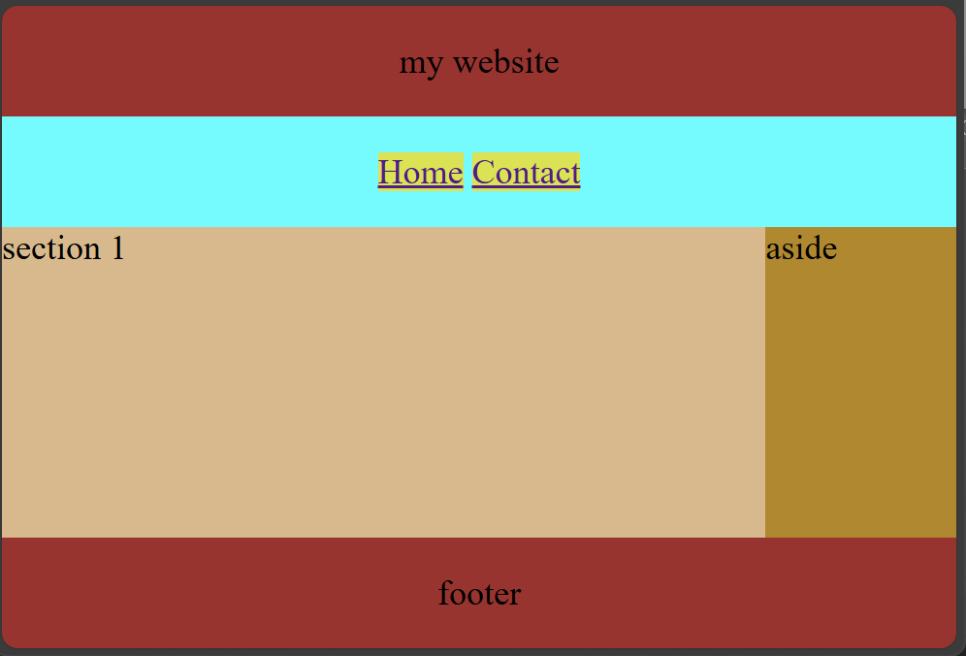
<header>my website</header>
<nav> <a href="#">Home</a> <a href="#">Contact</a> </nav>
<main>
<section>section 1</section>
<aside>aside</aside>
</main>
<footer>footer</footer>
</body>

